Slide 1
PHOTO EDITING - Development
CSE 611 – MS Project Development
Professor – Jinjun Xiong

Slide 2
TEAM MEMBERS
Pavana Lakshmi Venugopal
Saad Ahmed
Taraka Rohit Adusumilli
Ayesha Humaera

Slide 3
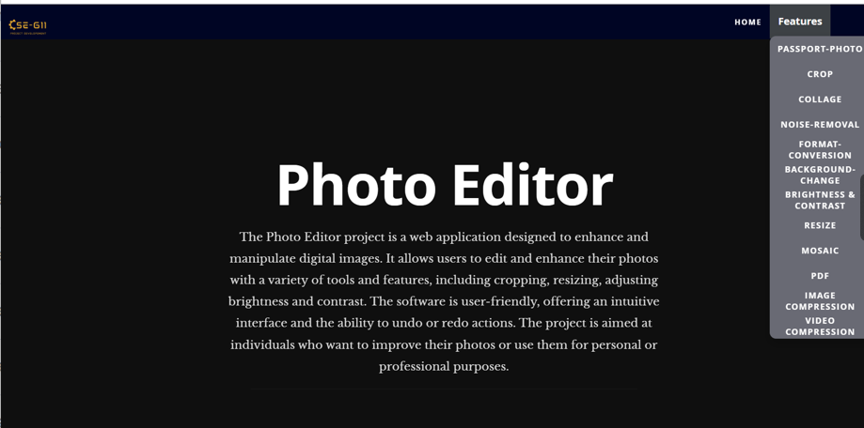
Updated Home Page

Slide 4
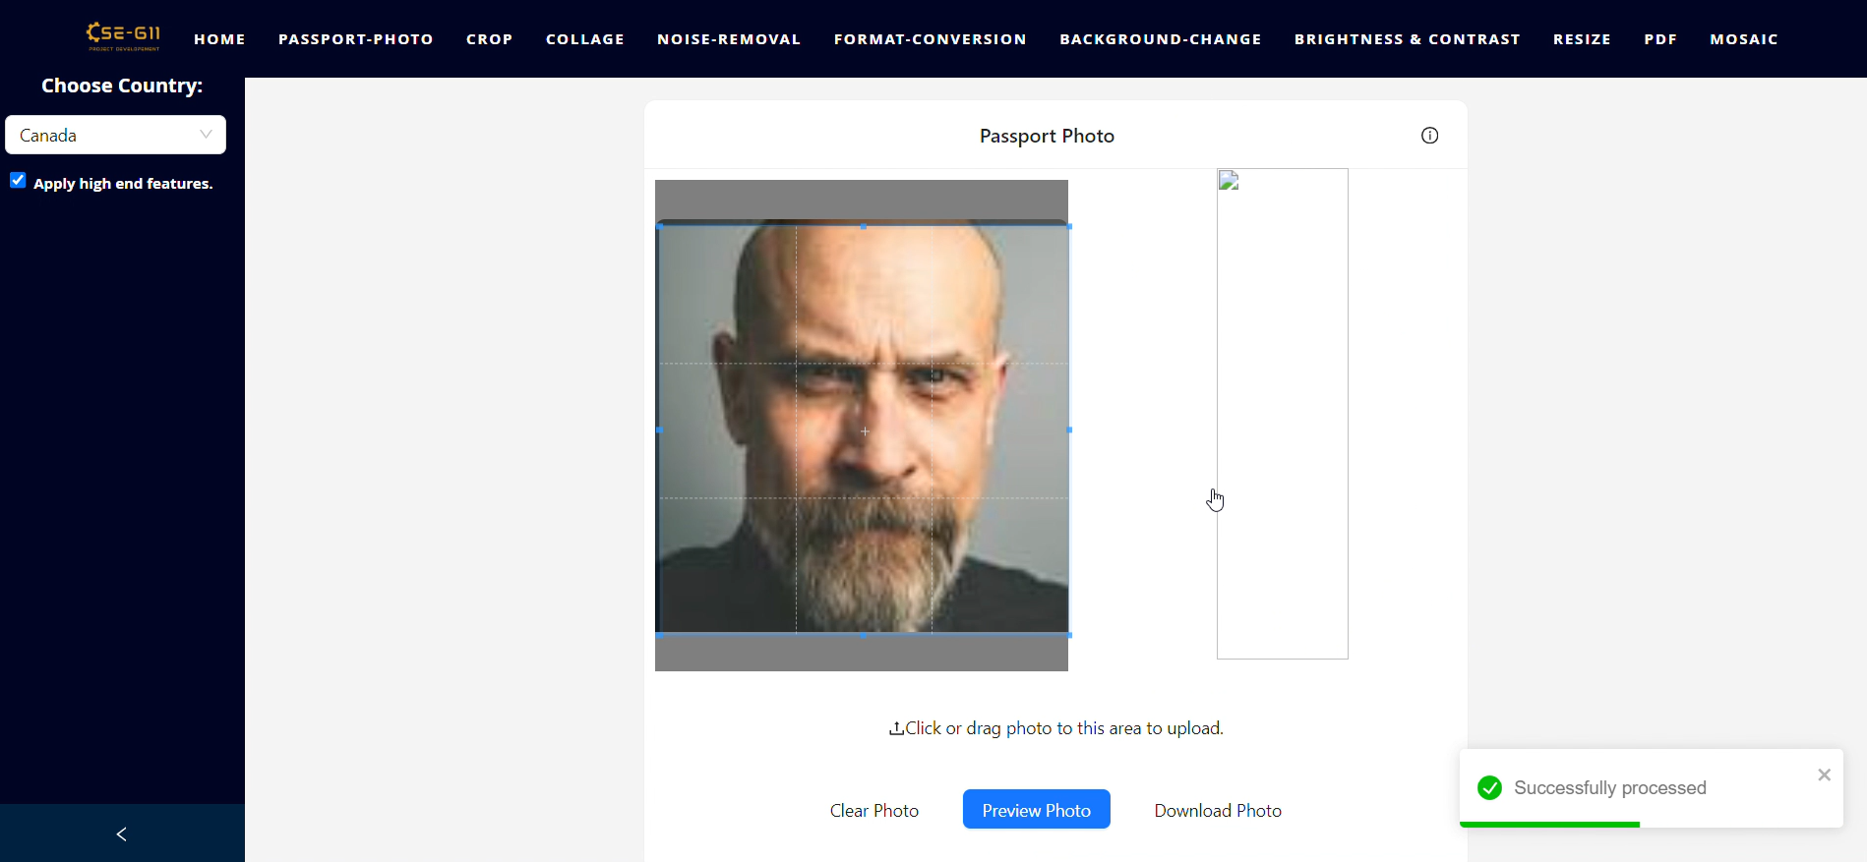
Apply high end features - Before fix

Slide 5
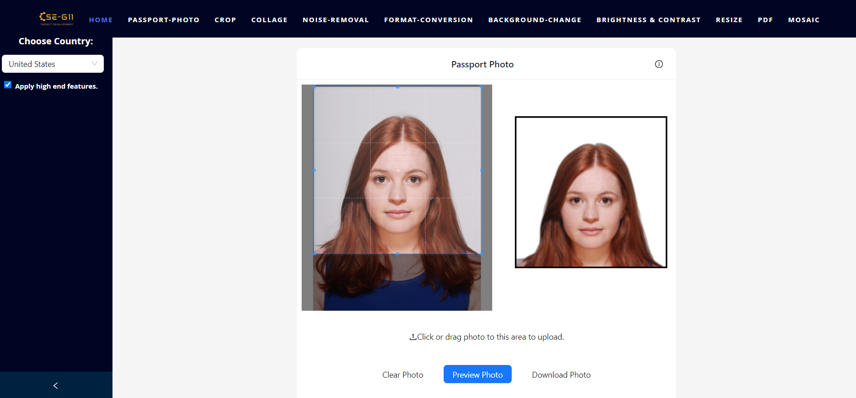
Apply high end features - After fix

Slide 6
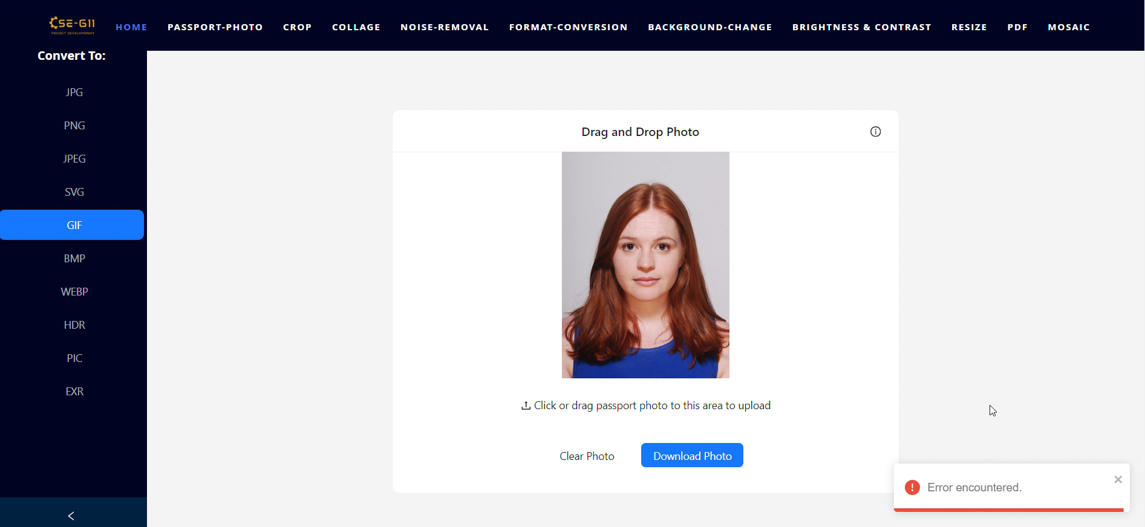
Format Conversion- Before fix

Slide 7
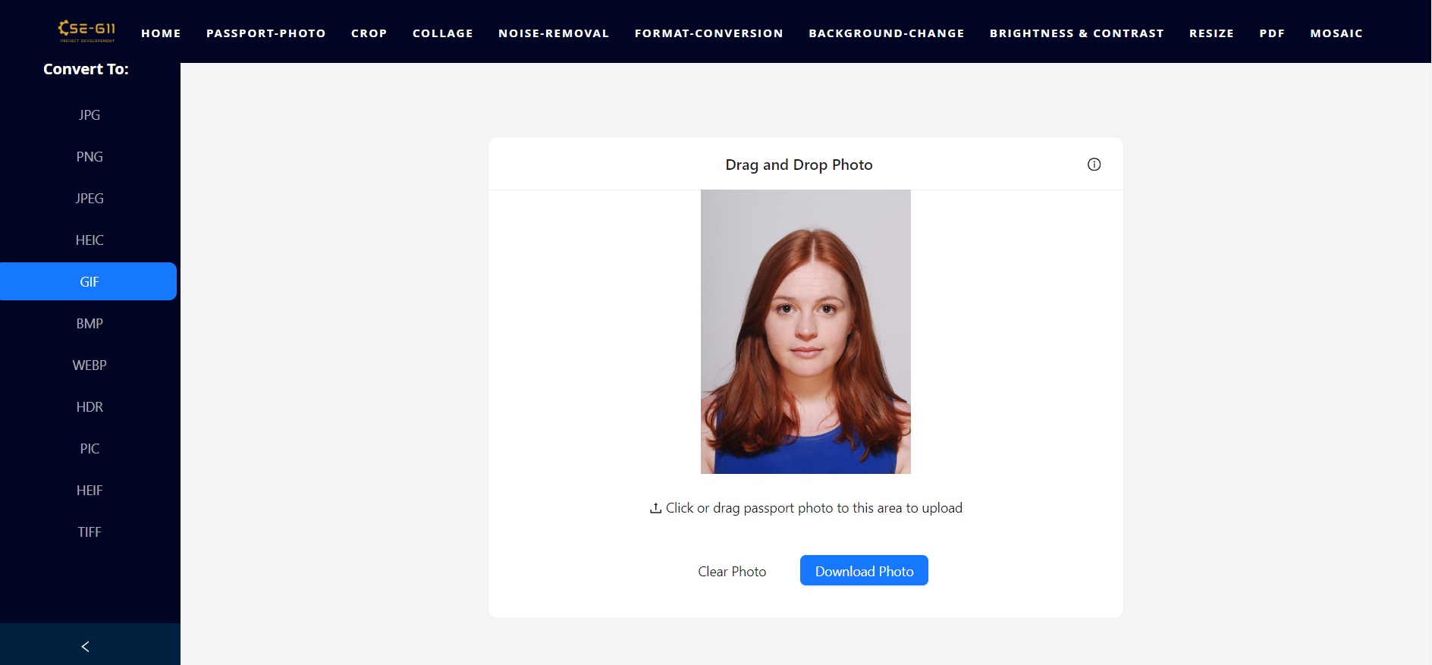
Format Conversion - After fix

Slide 8
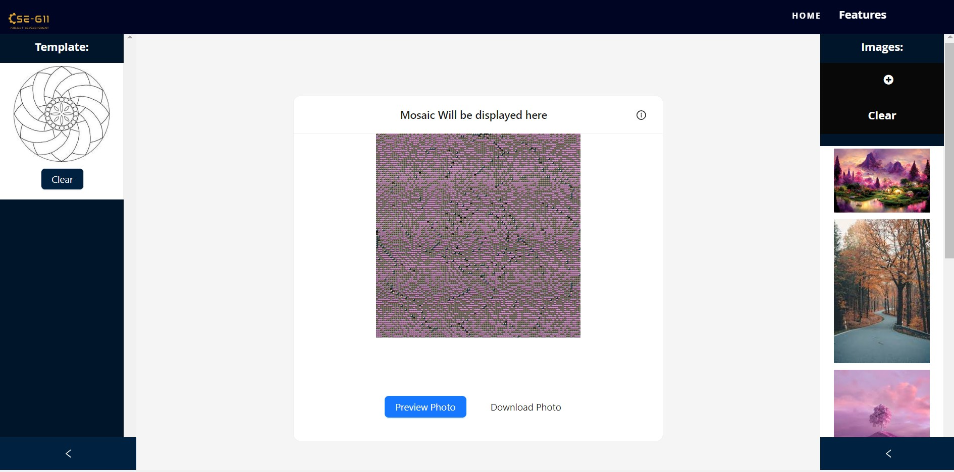
Mosaic Tool - Before Fix

Slide 9
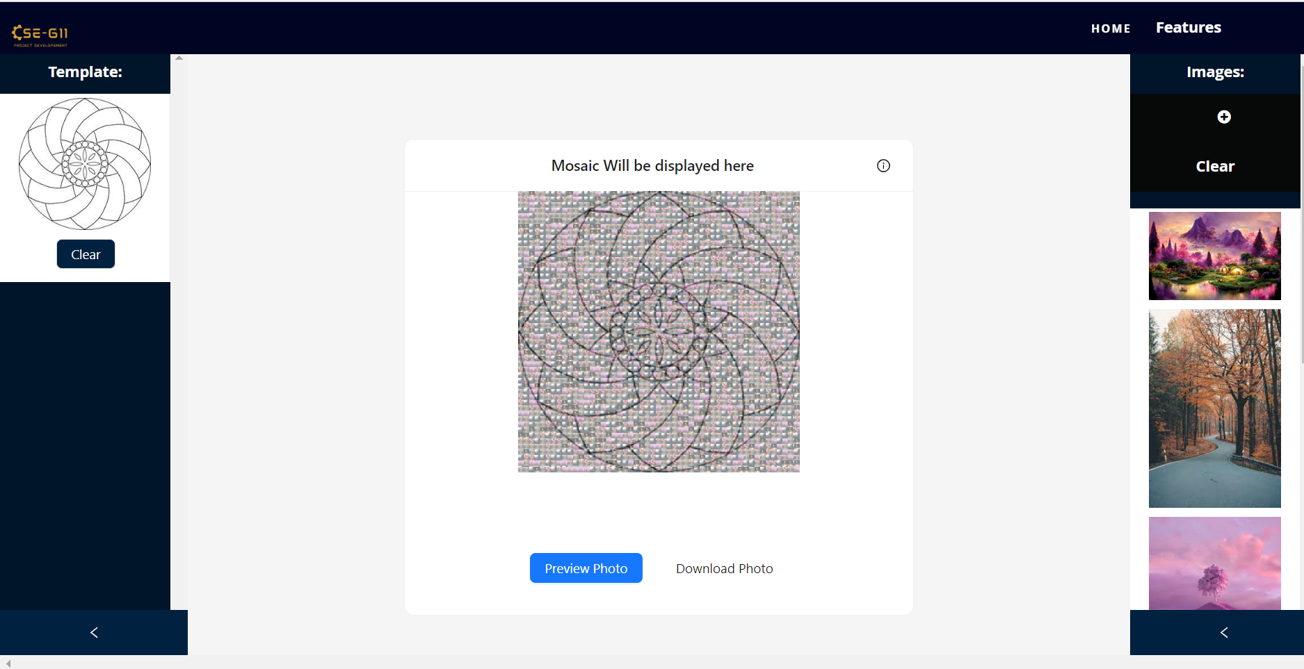
Mosaic Tool - After Fix

Slide 10
Thank you

